Slide 1
WebSphere Application Server WebSphere Troubleshooting and Performance Lab
Notes:
XMLFEP_Install.ppt
Page 1 of 32

Slide 2
What is it?
Self-paced, free, publicly downloadable WebSphere Liberty and WAS traditional troubleshooting and performance lab
Learn: CPU analysis, Hang determination, Performance tuning, Memory analysis, etc.
Over 100 pages of exercises which can be done in sequence or a la carte
Hosted on Quay.io
Install podman or Docker Desktop for Windows and macOS
podman/docker run ... quay.io/ibm/webspherelab (see instructions for details)
VNC/Remote Desktop into the lab
Notes:
XMLFEP_Install.ppt
Page 2 of 32

Slide 3
What’s in it?
Derby
tWAS 9.0.5.14
daytrader7
IHS
JMeter
OpenLDAP
Liberty 23.0.0.1
daytrader7
Derby
Fedora 37 Linux
Podman/Docker
Windows, macOS or Linux Host
Notes:
XMLFEP_Install.ppt
Page 3 of 32

Slide 4
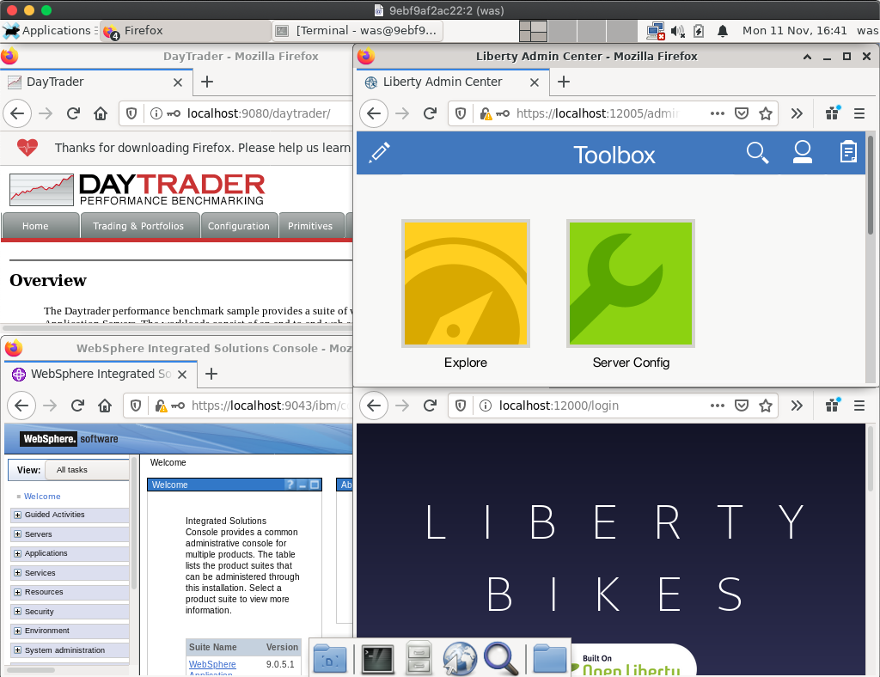
Screenshot
Notes:
XMLFEP_Install.ppt
Page 4 of 32

Slide 5
How to run it?
Windows/macOS: Configure Docker Desktop or podman:
Memory >= 4GB
Disk >= 30GB
Currently requires x86_64/amd64 CPU (others in the works)
Run the container from Command Prompt or Terminal:
podman run --cap-add sys_chroot --rm -p 5901:5901 -p 5902:5902 -p 3390:3389 -p 9080:9080 -p 9443:9443 -it quay.io/ibm/webspherelab
docker run --rm -p 5901:5901 -p 5902:5902 -p 3390:3389 -p 9080:9080 -p 9443:9443 -it quay.io/ibm/webspherelab
Wait 5 minutes until you see:
========= = READY = =========
Notes:
XMLFEP_Install.ppt
Page 5 of 32

Slide 6
How to run it?
Remote into the container:
VNC to localhost:5902
From the Terminal in macOS: open vnc://localhost:5902
Linux Terminal: vncviewer localhost:5902
Windows 3rd party VNC viewers
Windows Remote Desktop: Requires configuration; see lab appendix
Perform the step-by-step lab: https://github.com/IBM/webspherelab/blob/main/Liberty_Perf_Lab.md
Also available on the desktop inside the lab
Notes:
XMLFEP_Install.ppt
Page 6 of 32

Slide 7
Auto-tuning Thread Pool
Traditional Tuning
Application thread pools
Connection Pools (e.g. database, JMS, etc.)
Java Virtual Machine
Liberty Tuning
Application thread pools (Auto-tuning)
Operating System
Network
Connection Pools (e.g. database, JMS, etc.)
Java Virtual Machine
Operating System
Network
Performance Test
Per-Application Tuning
Deploy to Production
Production Tuning
Application Changes
Notes:
A key differentiator of WebSphere Liberty is its auto-tuning main thread pool that dynamically changes the maximum thread pool size to try to maximize throughput. In most cases, this means that an administrator does not need to specify nor tune the main application thread pool. Note that other pools such as database connection pools, web service client pools and others do not auto-tune as those are backend resources out of the control of Liberty, so they must still be tuned.

Slide 8
Major Recommended Tools
Tool | Analyze | Purpose
top -H or equivalent | CPU by Thread | Performance/Hang
monitor-1.0 / AdminCenter | Various statistics | Performance/Hang
requestTiming-1.0 & Access Log | Response times | Performance/Hang
Thread and Monitor Dump Analyzer (TMDA) | Thread dumps | Performance/Hang
Garbage Collection and Memory Visualizer (GCMV) | Verbose garbage collection | Performance/Hang
Eclipse Memory Analyzer Tool (MAT) | Heapdumps | OutOfMemoryError
Java Health Center | IBM Java | CPU Deep Dive
Notes:
XMLFEP_Install.ppt
Page 8 of 32

Slide 9
Liberty Tuning Top 10 Tips
Ensure your operating system CPU, RAM, disk, and network aren’t saturated
Ensure time in Java garbage collection is less than ~5%; tune max heap size and nursery heap size
Liberty’s main thread pool auto-tunes for throughput and generally should not be tuned
Monitor arrival rate, response times, utilization, error rate and throughput at each layer and investigate with thread dumps and/or a sampling profiler
If using databases, tune the maximum connection pool size (and make sure the DB supports it)
If using JMS MDBs, tune the maxConcurrency
If using security, tune the authentication cache size
Consider enabling request timing to watch for slow HTTP requests
Consider enabling the HTTP access log to understand and tune HTTP activity
Aggressively use caching where possible For more, see the Liberty Performance Tips and the WebSphere Performance Cookbook

Slide 10
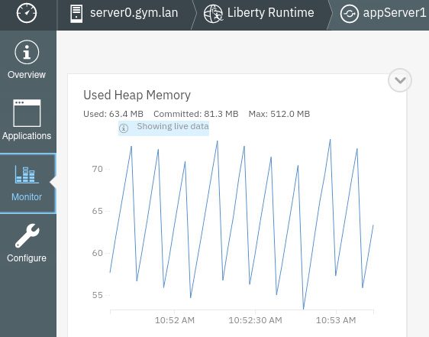
Monitoring statistics
Java MXBeans are a standardized mechanism to expose statistics
Enable monitor-1.0 feature
Admin Center
Produce
Consume
Instana
Eclipse MicroProfile Metrics
3rd Party Tools
JConsole
Prometheus
GET /metrics scripts
Java heap
Threads
CPU
Response Times
Connection pools
HTTP sessions
… and more …
Notes:
The monitor-1.0 feature gathers and exposes statistics about WebSphere Liberty such as thread pool utilization, response times, and more through standardized Java MXBeans. Most commonly, this data is consumed through monitoring products such as Instana; however, a key differentiator to other application servers is that WebSphere Liberty also has basic visualization built-in through the Admin Center.
You may connect the JConsole monitoring tool built into Java and access Liberty enabled with the monitor-1.0 feature through the localConnector-1.0 and/or restConnector-2.0 features; however, note that JConsole has connection complexities and limited capabilities and Admin Center is often enough for basic statistics visualization.

Slide 11
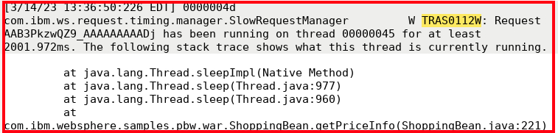
Slow and hung request detection
Enable
Enable requestTiming-1.0 feature
Configure slow and hung thresholds <requestTiming slowRequestThreshold="2000ms" hungRequestThreshold="600s" sampleRate="1" />
Monitor
Liberty watches all or a sampling of requests
If a request exceeds a threshold, a warning (TRAS0112W) is printed to the logs
Analyze
Stack trace at the time threshold exceeded
Tree of events leading up to the breach
Time stamp of the breach
Servlet time
EJB method time
JDBC request time
JDBC request time
EJB method time
A single request with a tree of events
RequestID: AAC9KLWFFXT_AAAAAAAAN
Notes:
A key differentiator of WebSphere Liberty is its slow and hung request detection available through the requestTiming-1.0 feature. You can specify a threshold for what the application stakeholders define as an excessively slow web request and Liberty watches requests and prints a stack trace and other details when a request exceeds such a threshold.

Slide 12
Demo
Notes:
XMLFEP_Install.ppt
Page 12 of 32

Slide 13
Thank you.
Questions?
Notes:
XMLFEP_Install.ppt
Page 13 of 32

Slide 14
Appendix
Notes:
XMLFEP_Install.ppt
Page 14 of 32

Slide 15
Performance Tuning in Containers
Check overall cluster utilization and pod utilization and limits
Scale number of pods: Horizontal pod autoscaler
Java:
Use neither -XX:MaxRAMPercentage nor -Xmx, or the former if needed
Consider a mounted shared class cache
Enable rotating verbosegc: -Xverbosegclog:logs/verbosegc.%seq.log,20,50000
Consider using the JITServer
Liberty:
Consider using InstantOn
Use JSON logging
Run configure.sh in the Containerfile

Slide 16
Other Day 2 Capabilities
Ensure time spent in garbage collection is less than ~5-10% using the free GCMV tool.
Review performance tuning guidance and the WebSphere Performance Cookbook.
Consider integrating the WebSphere Automation product that helps with server inventory, security patching, and automatic memory leak detection and diagnosis.
Use the free IBM Thread and Monitor Dump Analyzer (TMDA) to graphically review thread dumps.
To review OutOfMemoryErrors, use the free Eclipse Memory Analyzer Tool (MAT) with DTFJ and IBM Extensions.

Slide 17
Other Day 2 Capabilities
An optional servlet response cache that takes significant effort to configure but may have a dramatic return on investment in reduced server utilization and improved response times.
Distributed tracing to monitor the flow of JAX-RS web service calls through a web of Liberty processes.
Consider grouping Liberty servers running the same application into Liberty clusters for easier management.
Consider the auto scaling features to dynamically scale the number of Liberty servers based on CPU and memory.
Dynamic routing rules in a collective may be used to route requests to specific servers, redirect requests, or reject requests.

Slide 18
Other Day 2 Capabilities
If running WebSphere Liberty on IBM Java or IBM Semeru Runtimes:
A shared class cache to improve startup time.
Various garbage collection policies for different workloads.
Richer thread dumps to help diagnose many types of issues.
Method tracing to take diagnostic actions on method entry or exit, or to time method calls.
A dump engine to gather diagnostics on various events such as large object allocations, thrown or caught exceptions, etc.
A JITServer to separate Just-In-Time compilation into a separate process and share compiled code across processes.
The IBM Java Health Center sampling profiler available in IBM Java 8 and IBM Semeru Runtimes 11 on z/OS to investigate Java CPU usage and lock contention.
For richer memory analysis, consider enabling and configuring core dumps (e.g. core and file ulimits, kernel.core_pattern truncation settings, etc.) after reviewing the security, disk and performance risks.

Slide 19
Other Day 2 Capabilities
Consider using maintenance mode for clusters during diagnostics or maintenance operations.
Consider using health policies to capture diagnostics and perform other operations based on different conditions.
Flexible diagnostic trace capabilities with the option of using a binary output format for reduced overhead.
Gather basic operating system metrics such as CPU, memory, disk, and network utilization, saturation, and errors.
Gather operating system logs and watch for warnings and errors.
Monitor for common network issues such as TCP retransmissions.
Monitor the web server's access and error logs for warnings and errors.

Slide 20
Other Day 2 Capabilities
Monitor the web server's utilization with tools such as mod_mpmstats and mod_status.
For newer applications, advanced capabilities for fault tolerance such as automatic retries, circuit breakers, fallbacks, and bulkheads. In addition, health checks may be enabled using readiness and liveness probes.
When running in a container environment such as OpenShift:
Consider deploying applications using the WebSphere Liberty Operator and use capabilities such as the WebSphereLibertyTrace and WebSphereLibertyDump custom resources.
Consider enabling application monitoring integrated with and Grafana.
If you have cluster-admin permissions, use the MustGather: Performance, hang, or high CPU issues with WebSphere Application Server on Linux on Containers during performance, hang, and high-CPU issues.

